Slide 1

Demedicalising PrEP for MSM
Sheena McCormack
MRC Clinical Trials Unit at UCL
56 Dean Street

Slide 2
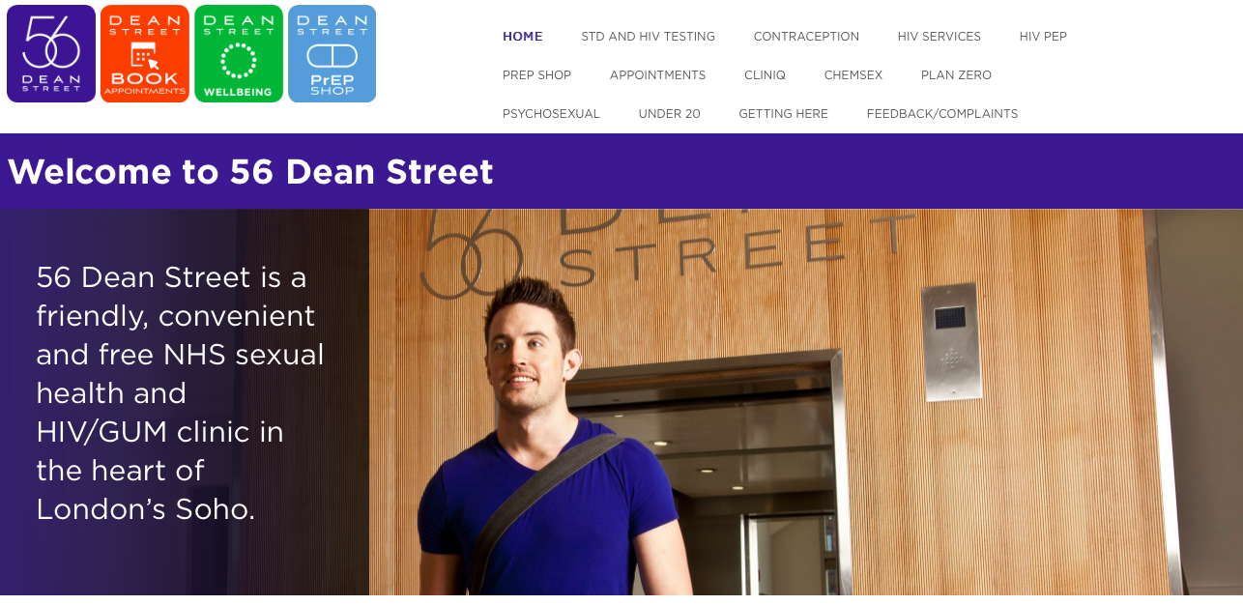
56 Dean Street

Slide 3
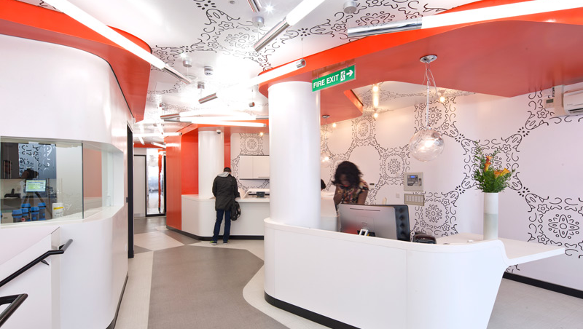
Dean Street Express

Slide 4
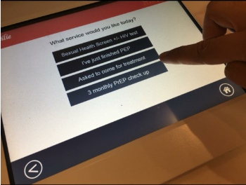


STI treatment, PEP, PrEP, VLs

Slide 5
Treatment and vaccination
Ensures short time to treatment - same day
Viral loads sent by text in the undetectables who can pick up 6m treatment later in the day
Stat dose where possible – it’s done
Partner notification directly or using ‘contact slips’ or e-services
Vaccination: hep A, B, HPV

Slide 6
Gold card and PRIME
Launched at Dean Street Express in 2016
HIV/STI tests available on walk-in basis once a month
  Rectal infections
  Syphilis
  PEP in the last year

Slide 7
Capacity and context
12,500 STD attendances per month
60% attendances are MSM
4,200 people living with HIV, seen twice a year if stable
Since 2014 strong focus on reducing undiagnosed HIV particularly in MSM and putting people on treatment to prevent onward transmission
50% of new diagnoses early infection (within 4 months)

Slide 8
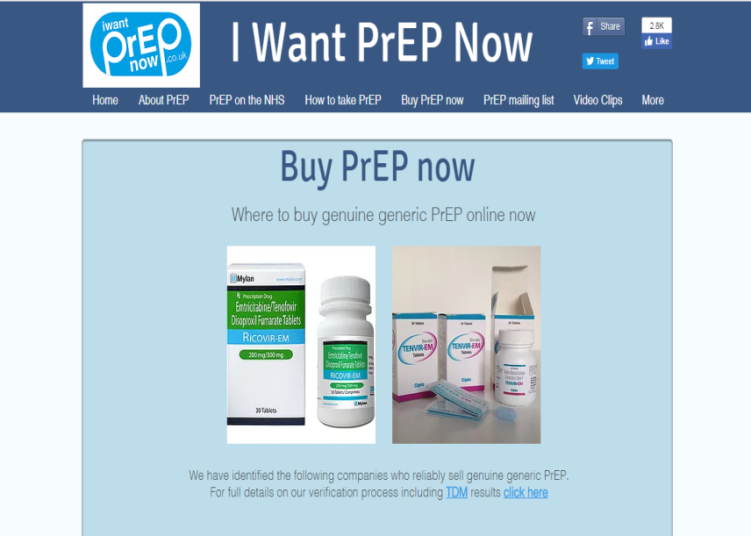
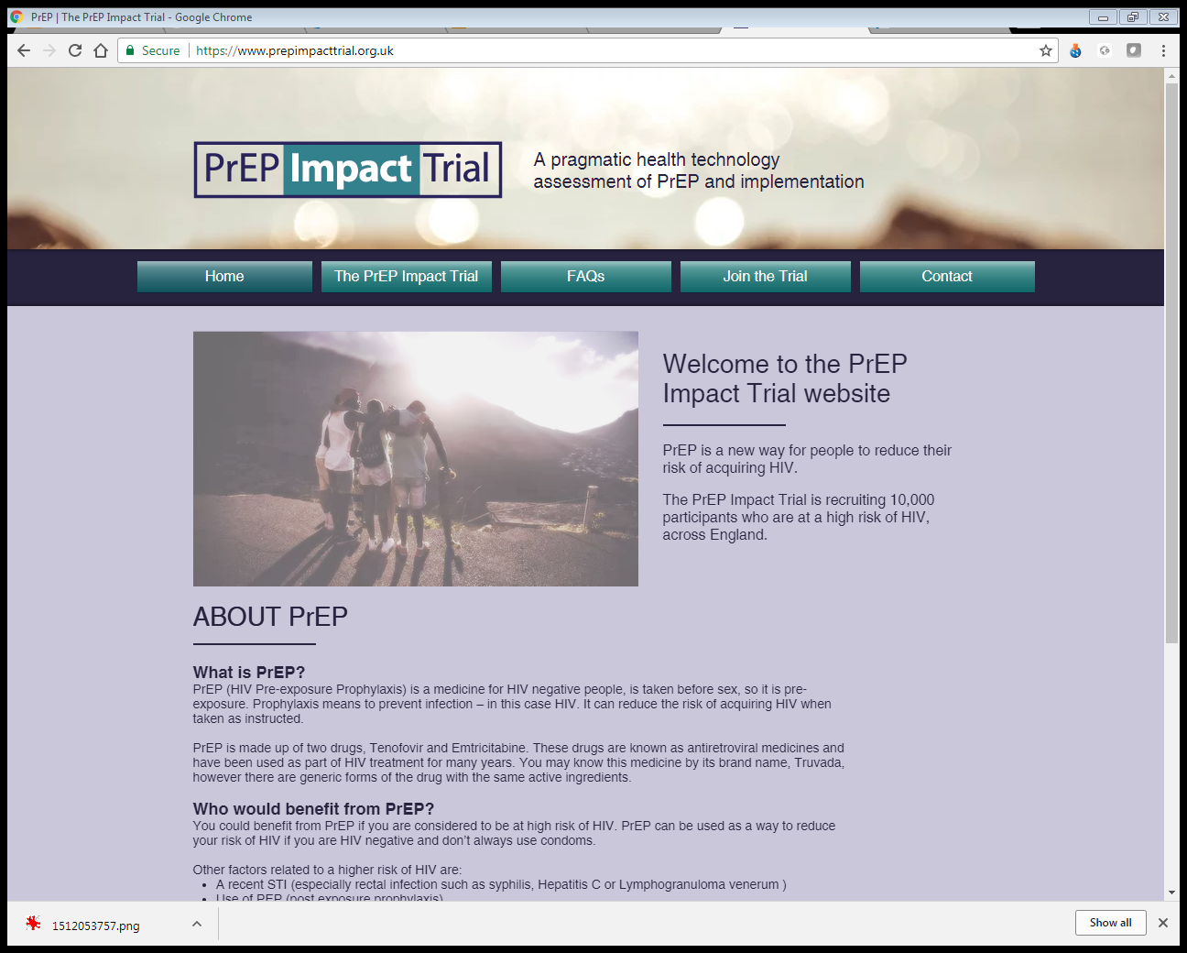
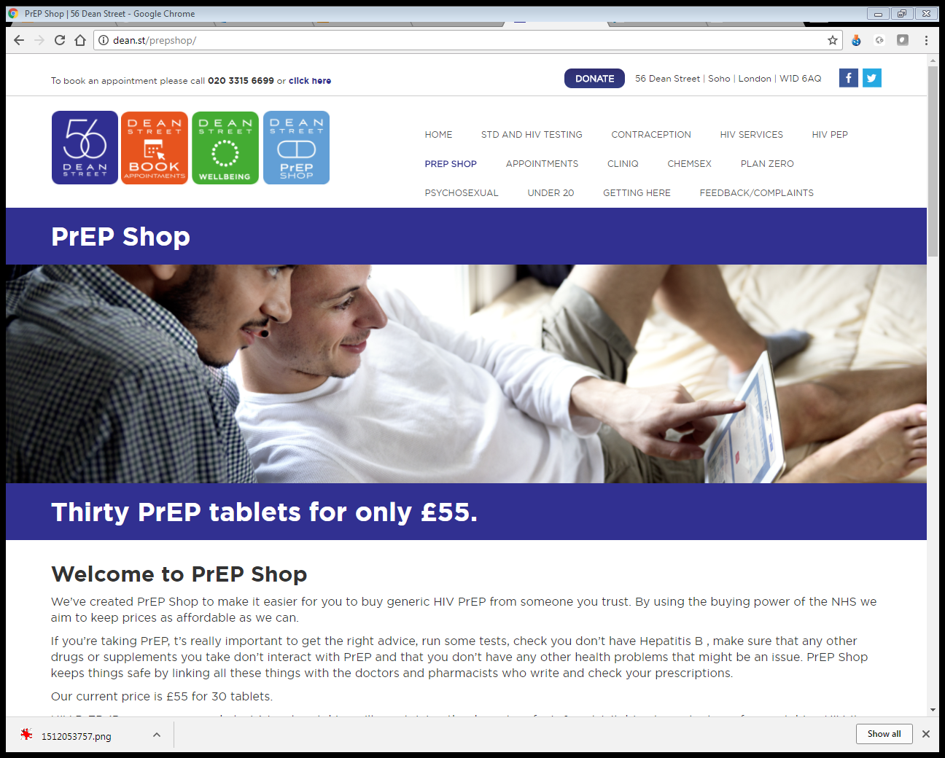
PrEP access
Online generics ~1000
PrEP Impact trial 1700
PrEP Shop run by clinic >1000

Slide 9

Community-run service in clinic
CliniQ – by us, for us, trans-led service
  Family, partners, anyone questioning their gender welcome
Comprehensive
  Hormones
  Yoga, art, acupuncture, hypnotherapy
  Benefit advice
  Peer mentorship and group therapy
www.cliniQ.org.uk

Slide 10
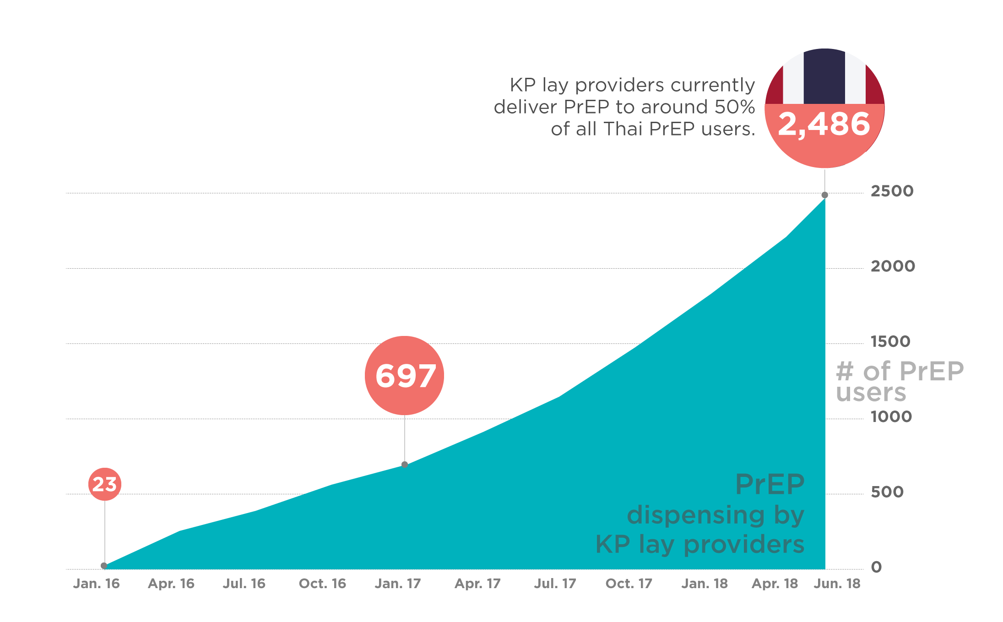
Princess PrEP programme
Key population led service
  HIV counselling and testing, ARV for PrEP and treatment
Source: Princess PrEP ART database, Thai Red Cross Anonymous Clinic (January 2016-June 2018).

Slide 11
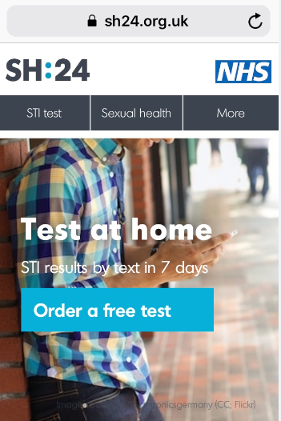
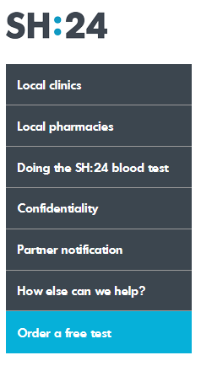
Online services: SH24
Mobile friendly and online
4th Joint BHIVA/BASHH
19 April 2018

Slide 12
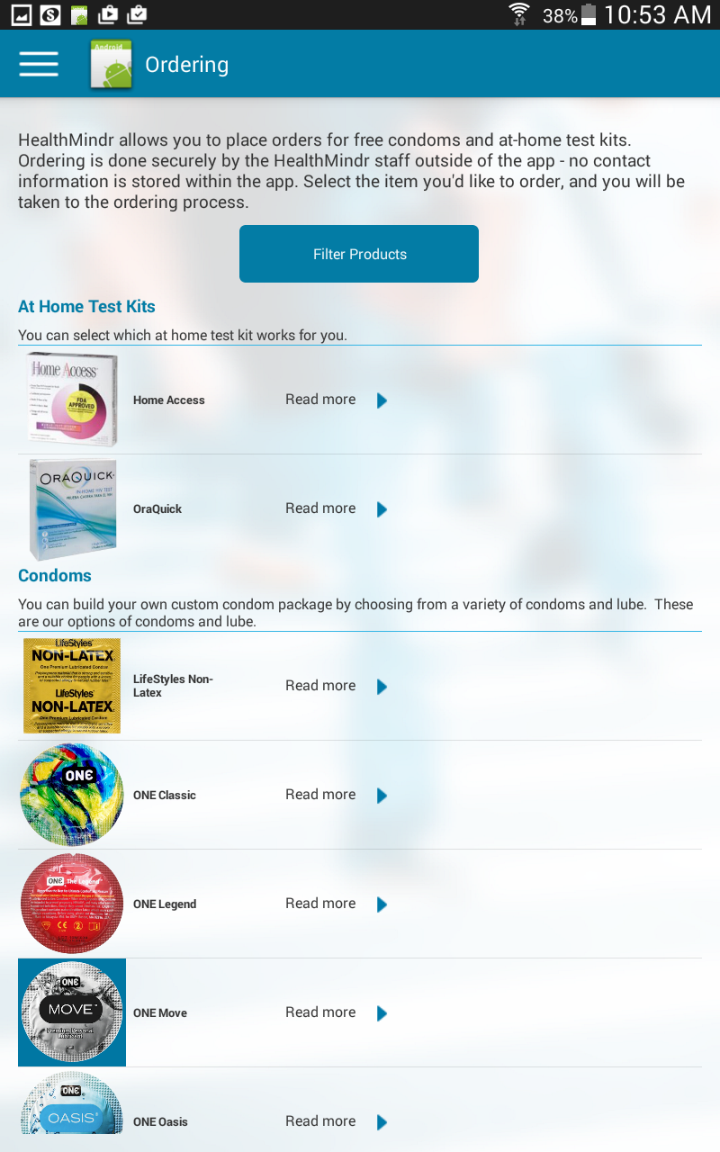
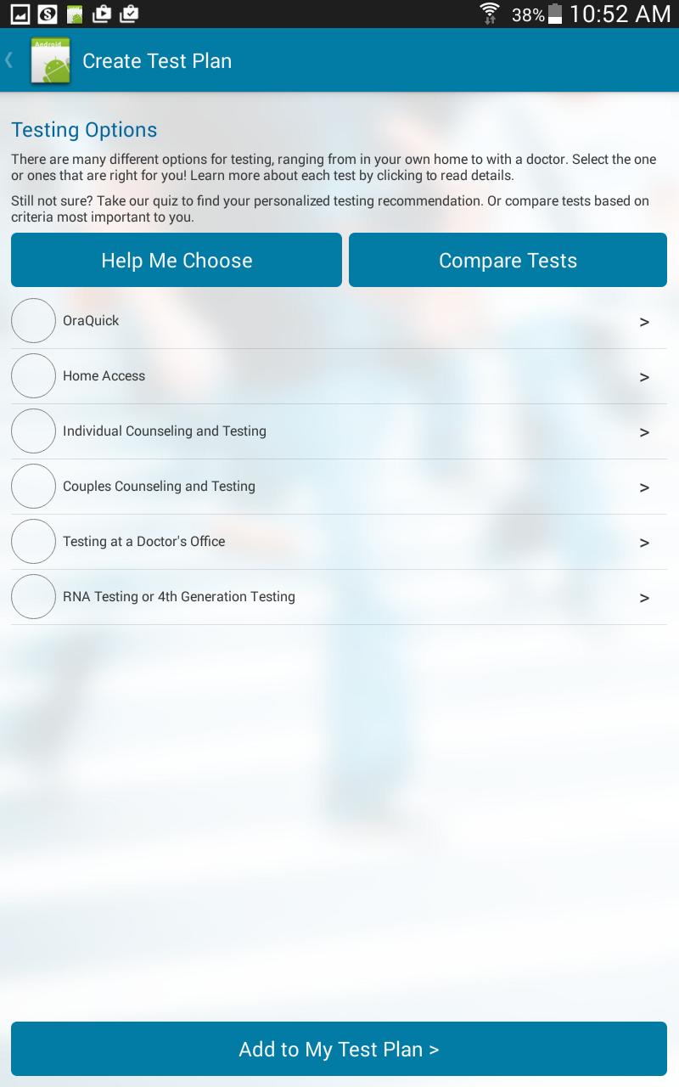


Slide 13








Highlights & Timelines
COMPARE
Highlights:
5 Aims completed (stars)
7 studies in the field
142 participants enrolled
Oct 2016
Oct 2017
Oct 2018
Oct 2019
Oct 2020
June 2021

Slide 14
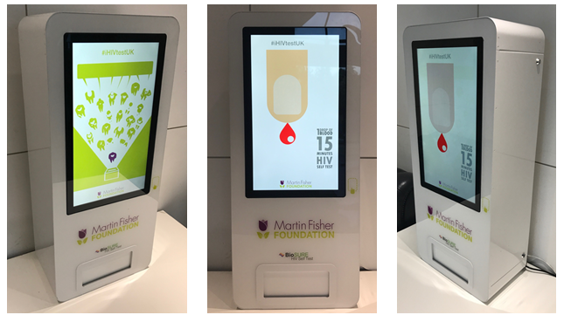
Digital vending machine
BioSURE HIV self-tests: 3rd generation
Wall mounted at eye level
Touch screen
Robust - liquid proof – secure (>300 machines, no incidents)
Lifespan ‘hundreds of thousands’ of vends
Little maintenance, can be done remotely
Access website for live monitoring of sales, issues and epidemiological data
Installed Brighton Sauna
June 2017

Slide 15
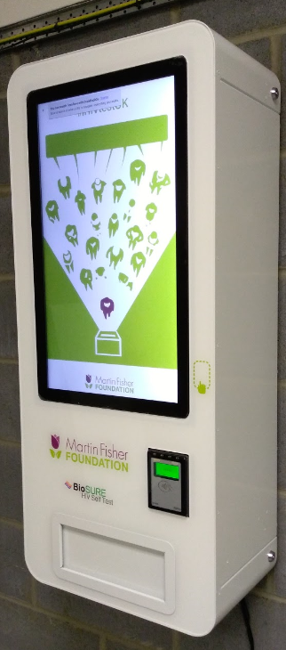
Next generation machine
More robust / tamper-proof
More reliable, 50% more powerful
~£3,500 vs £18,000 for prototype
Available through the Martin Fisher Foundation
Can dispense free tests or have contactless payment option
Option to have interaction in different languages

Slide 16
Concluding thoughts
Most PrEP users are healthy and motivated and can self-manage very well with minimal face to face support
Still need a highly skilled hub
  may even need a doctore when there are concomitant medications or co-morbidities
Otherwise best to deliver PrEP where it is most convenient
  where people are already going – or are (telemedicine)
  when it suits them
Important to ensure consistent messages across the social media spectrum

Slide 17


Acknowledgements
Dean Street
  Alan McOwan, Nneka Nwokolo, Emma Devitt, Sheel Patel, Gary Whitlock, Tara Suchack
CliniQ
  Michelle Ross and Aedan Wolton
Thai Red Cross and Princess PrEP
  Nittaya Phanuphak Pungpapong
Brighton and Martin Fisher Foundation
  Gillian Dean, Suneeta Soni, Carrie Llewellyn, Carlos Peralta, Liliana Rodriguez, Jaime Vera
iTech projects
  Patrick Sullivan

